Slide 1
Banking Data Simulation Project
BOI Data Factory IDL
Interns: Debshata Choudhury, Anmol Gupta
Project Buddy: Karan P. Singh

Slide 2
Understanding the Client Architecture
How a large-scale banking data ecosystem operates - our starting point before building anything
Cloud & Storage
AWS CSSP with an S3-based Enterprise Data Lake for elastic compute and storage
Scalable cloud backbone
Data Engineering Platform
Cloudera with the Hadoop and Hive ecosystem for distributed big-data processing
Enterprise-grade processing
Sources & Integration
Teradata warehouse feeding data through MuleSoft integration services
Governed data ingestion
Analytics & Security
Tableau delivers dashboards while Azure Active Directory secures access
Trusted, secure insights

Slide 3
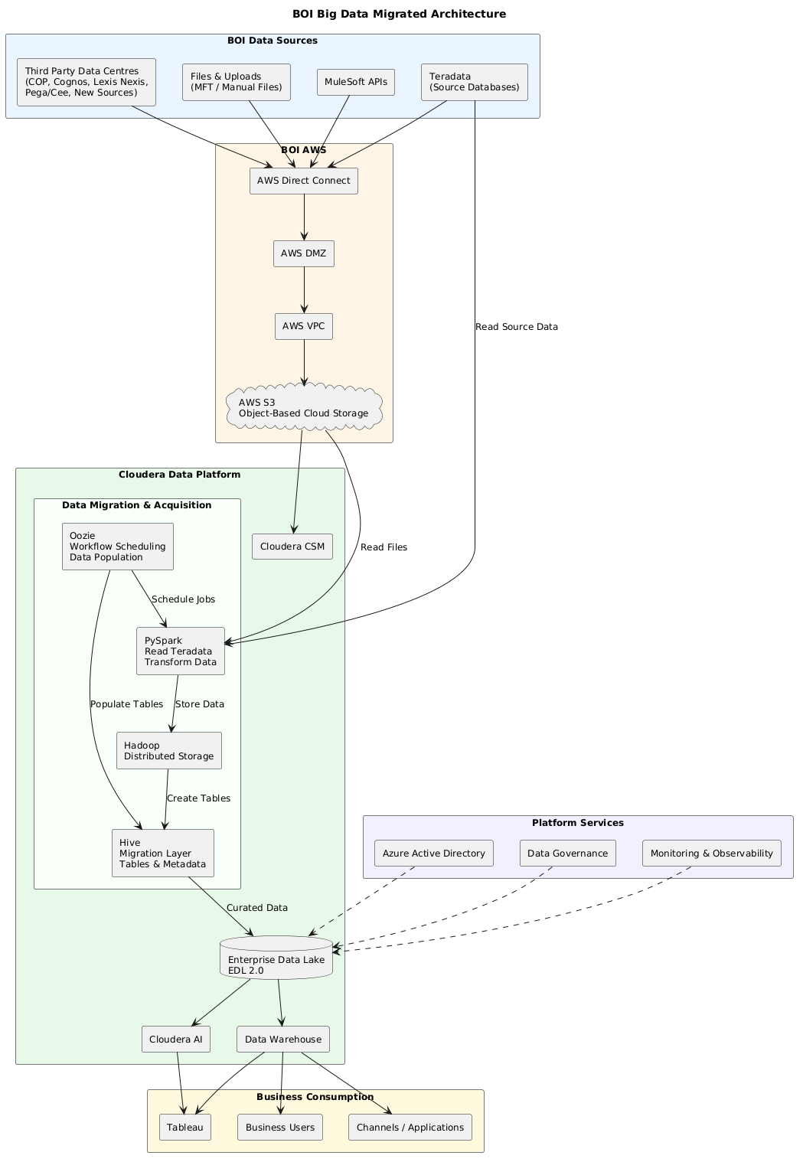
From Complex Architecture to Simplified Simulation
01
Teradata banking sources
AWS S3 storage layer
Cloudera data engineering
Enterprise Data Lake
Tableau dashboards
Client Architecture
02
We recreated the concepts and data flow - not the production complexity
Synthetic banking sources
Local storage layer
PySpark & Delta Lake engine
Bronze-Silver-Gold data lake
Power BI dashboard
Our Simulation

Slide 4
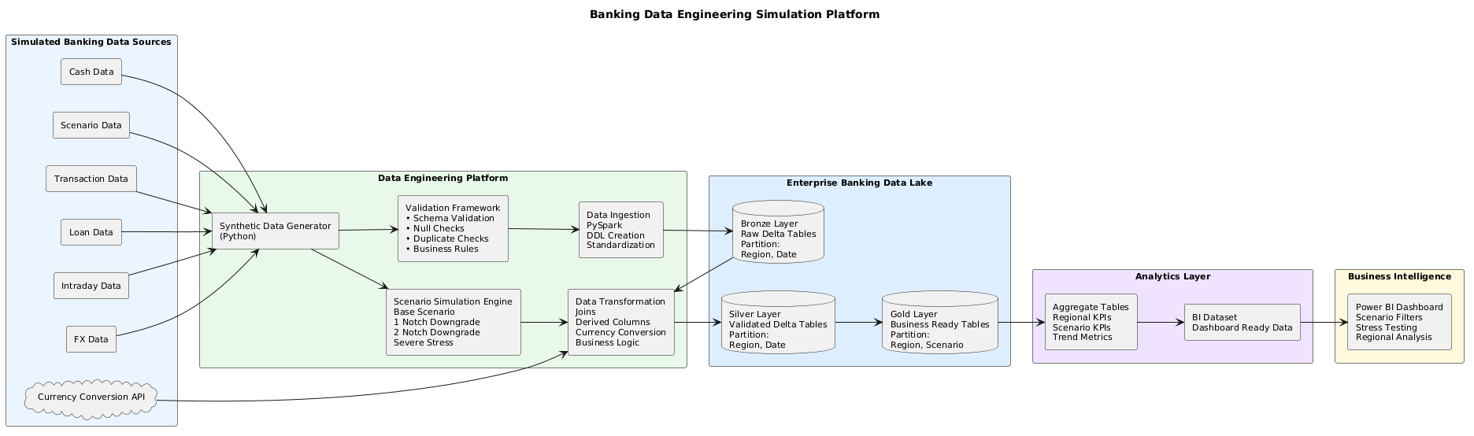
Banking Data Project Simulation

Slide 5
The Problem
Enterprise banking architectures are complex and hard for new engineers to grasp.
Many technologies and layers interact across the stack.
No small, safe environment exists to experiment and learn.
Teams still need analytics-ready outputs.
> Large architecture
> Rising complexity
> Learning gap

Slide 6
Action - Sprint Execution & Burndown
Sprint 1 · Jun 18-21
Setup, synthetic data, ingestion
Sprint 2 · Jun 22-Jul 2
Transformation, validation, orchestration
Sprint 3 · Jul 3-7
Medallion, dashboard, presentation

Slide 7
Challenges Faced & Learning Moments
The setbacks that became the turning point of the project
Environment setup took longer than expected
01
Ingestion and transformation responsibilities got mixed together.
Learning proper layer separation was the key lesson.
Turning point: Project Buddy Karan introduced Medallion Architecture.
New technologies to learn: PySpark, Delta Lake, big data concepts, AWS fundamentals
02
Generator and ingestion files were separated, adding modularization effort
03

Slide 8
Solution Architecture - Medallion Design
Raw data flows through Bronze, Silver and Gold layers into Power BI
01
02
03
04
05
Bronze
    Raw ingested data
      Schema captured as-is
Silver
    Cleaned & validated
      Nulls and duplicates removed
Gold
    Business-ready tables
      Joins and derived metrics
Aggregates
    KPI-ready summaries
      Optimized for reporting
Power BI
    Interactive dashboards
      Business insights

Slide 9
Action - Data Engineering Workflow
A standardized flow: Source, Validation, Transformation, Aggregation
01
02
03
04
Data Sources
Validation
Transformation
Aggregation
Loans
Deposits
Transactions
Liquidity
Intraday position
Schema validation
Null checks
Duplicate checks
Business validations
Dataset joins
Currency conversion
Derived columns
Business calculations
KPI aggregates
Scenario metrics
Analytics-ready outputs

Slide 10
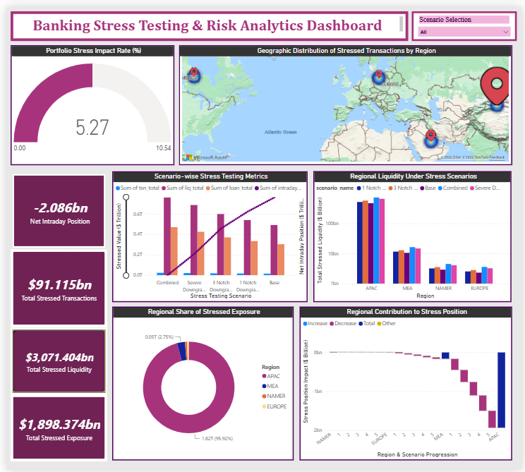
Insights - Power BI Dashboard
01
Scenario-based stress testing with dynamic filters
02
Real-time KPIs for Exposure, Liquidity & Transactions
03
Regional risk analysis across global markets
04
Interactive visualizations for risk insights & decision-making

Slide 11

What We Learned
01
Big Data & Cloud
  PySpark, Delta Lake, AWS storage, Hadoop & Hive
02
Data Engineering
  Medallion architecture, Power BI, pipeline design
03
Architecture
  Enterprise data lakes, Cloudera concepts, ecosystem analysis
04
Professional
  Project management, documentation, communication

Slide 12
The Impact of Our Work
From learning to reusable value
01
02
03
Immediate Impact
Future Impact
Value Created
Simplified architecture understanding
Concepts proven through simulation
Reusable learning framework
Scenario-based analytics
Faster onboarding for new interns
Simulation can be expanded
Serves as a proof-of-concept
Learning
Simulation
Analytics
Enterprise value

Slide 13
Scaling Toward the Client Architecture
Current: synthetic data, local implementation
Target: real Teradata ingestion & AWS S3 integration
Workflow scheduling & Hive metadata management
Enterprise Data Lake with Cloudera AI
Governance and monitoring
From Current State to Target State
How our simulation can evolve into a production-grade platform

Slide 14
Impact & Future Recommendations
A 30/60/90-day path from proof-of-concept to enterprise scale
01
02
03
04
Next 30 Days
Next 60 Days
Next 90 Days
Business Impact
Problem: enterprise architectures are hard to explain
Action: built a scalable simulation & analytics framework
Insight: medallion simplifies development & governance
Impact: reusable foundation for onboarding & scale
Productionize ingestion framework
Strengthen validation rules
Improve dashboard KPI coverage
Automate scheduling
Add monitoring & alerts
Expand scenario simulations
Integrate cloud storage
Add real-time data feeds
Implement governance layer
Enable AI-driven analytics

Slide 15
Thank You

